Slide 2
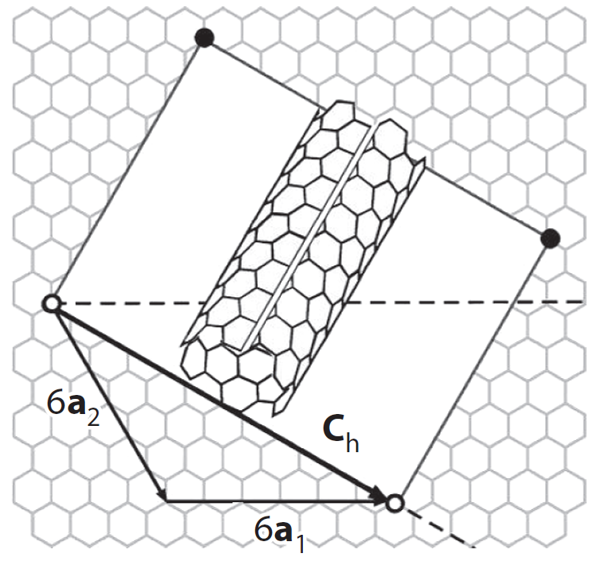
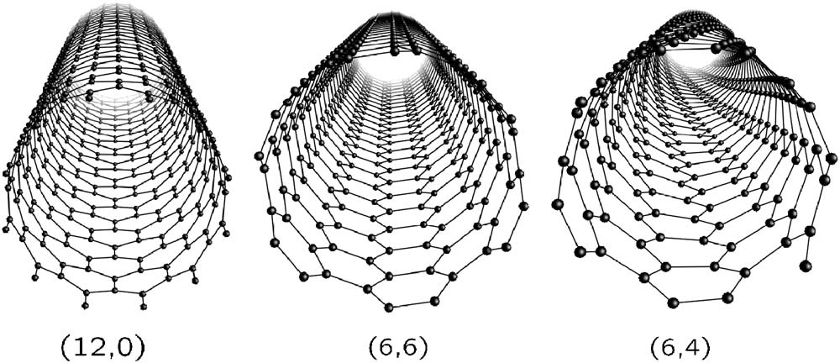
Carbon nanotubes can be visualized as rolled up sheets of graphene.

Slide 3
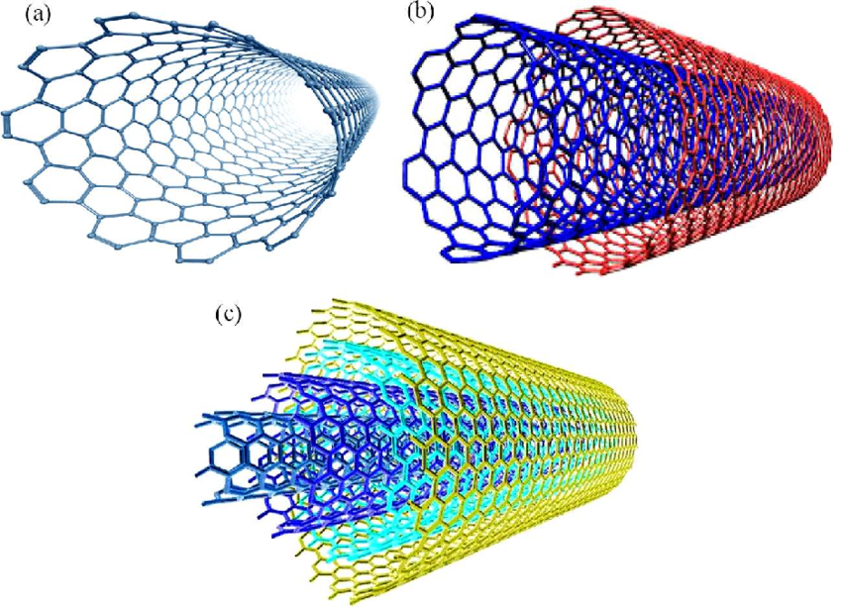

Slide 4
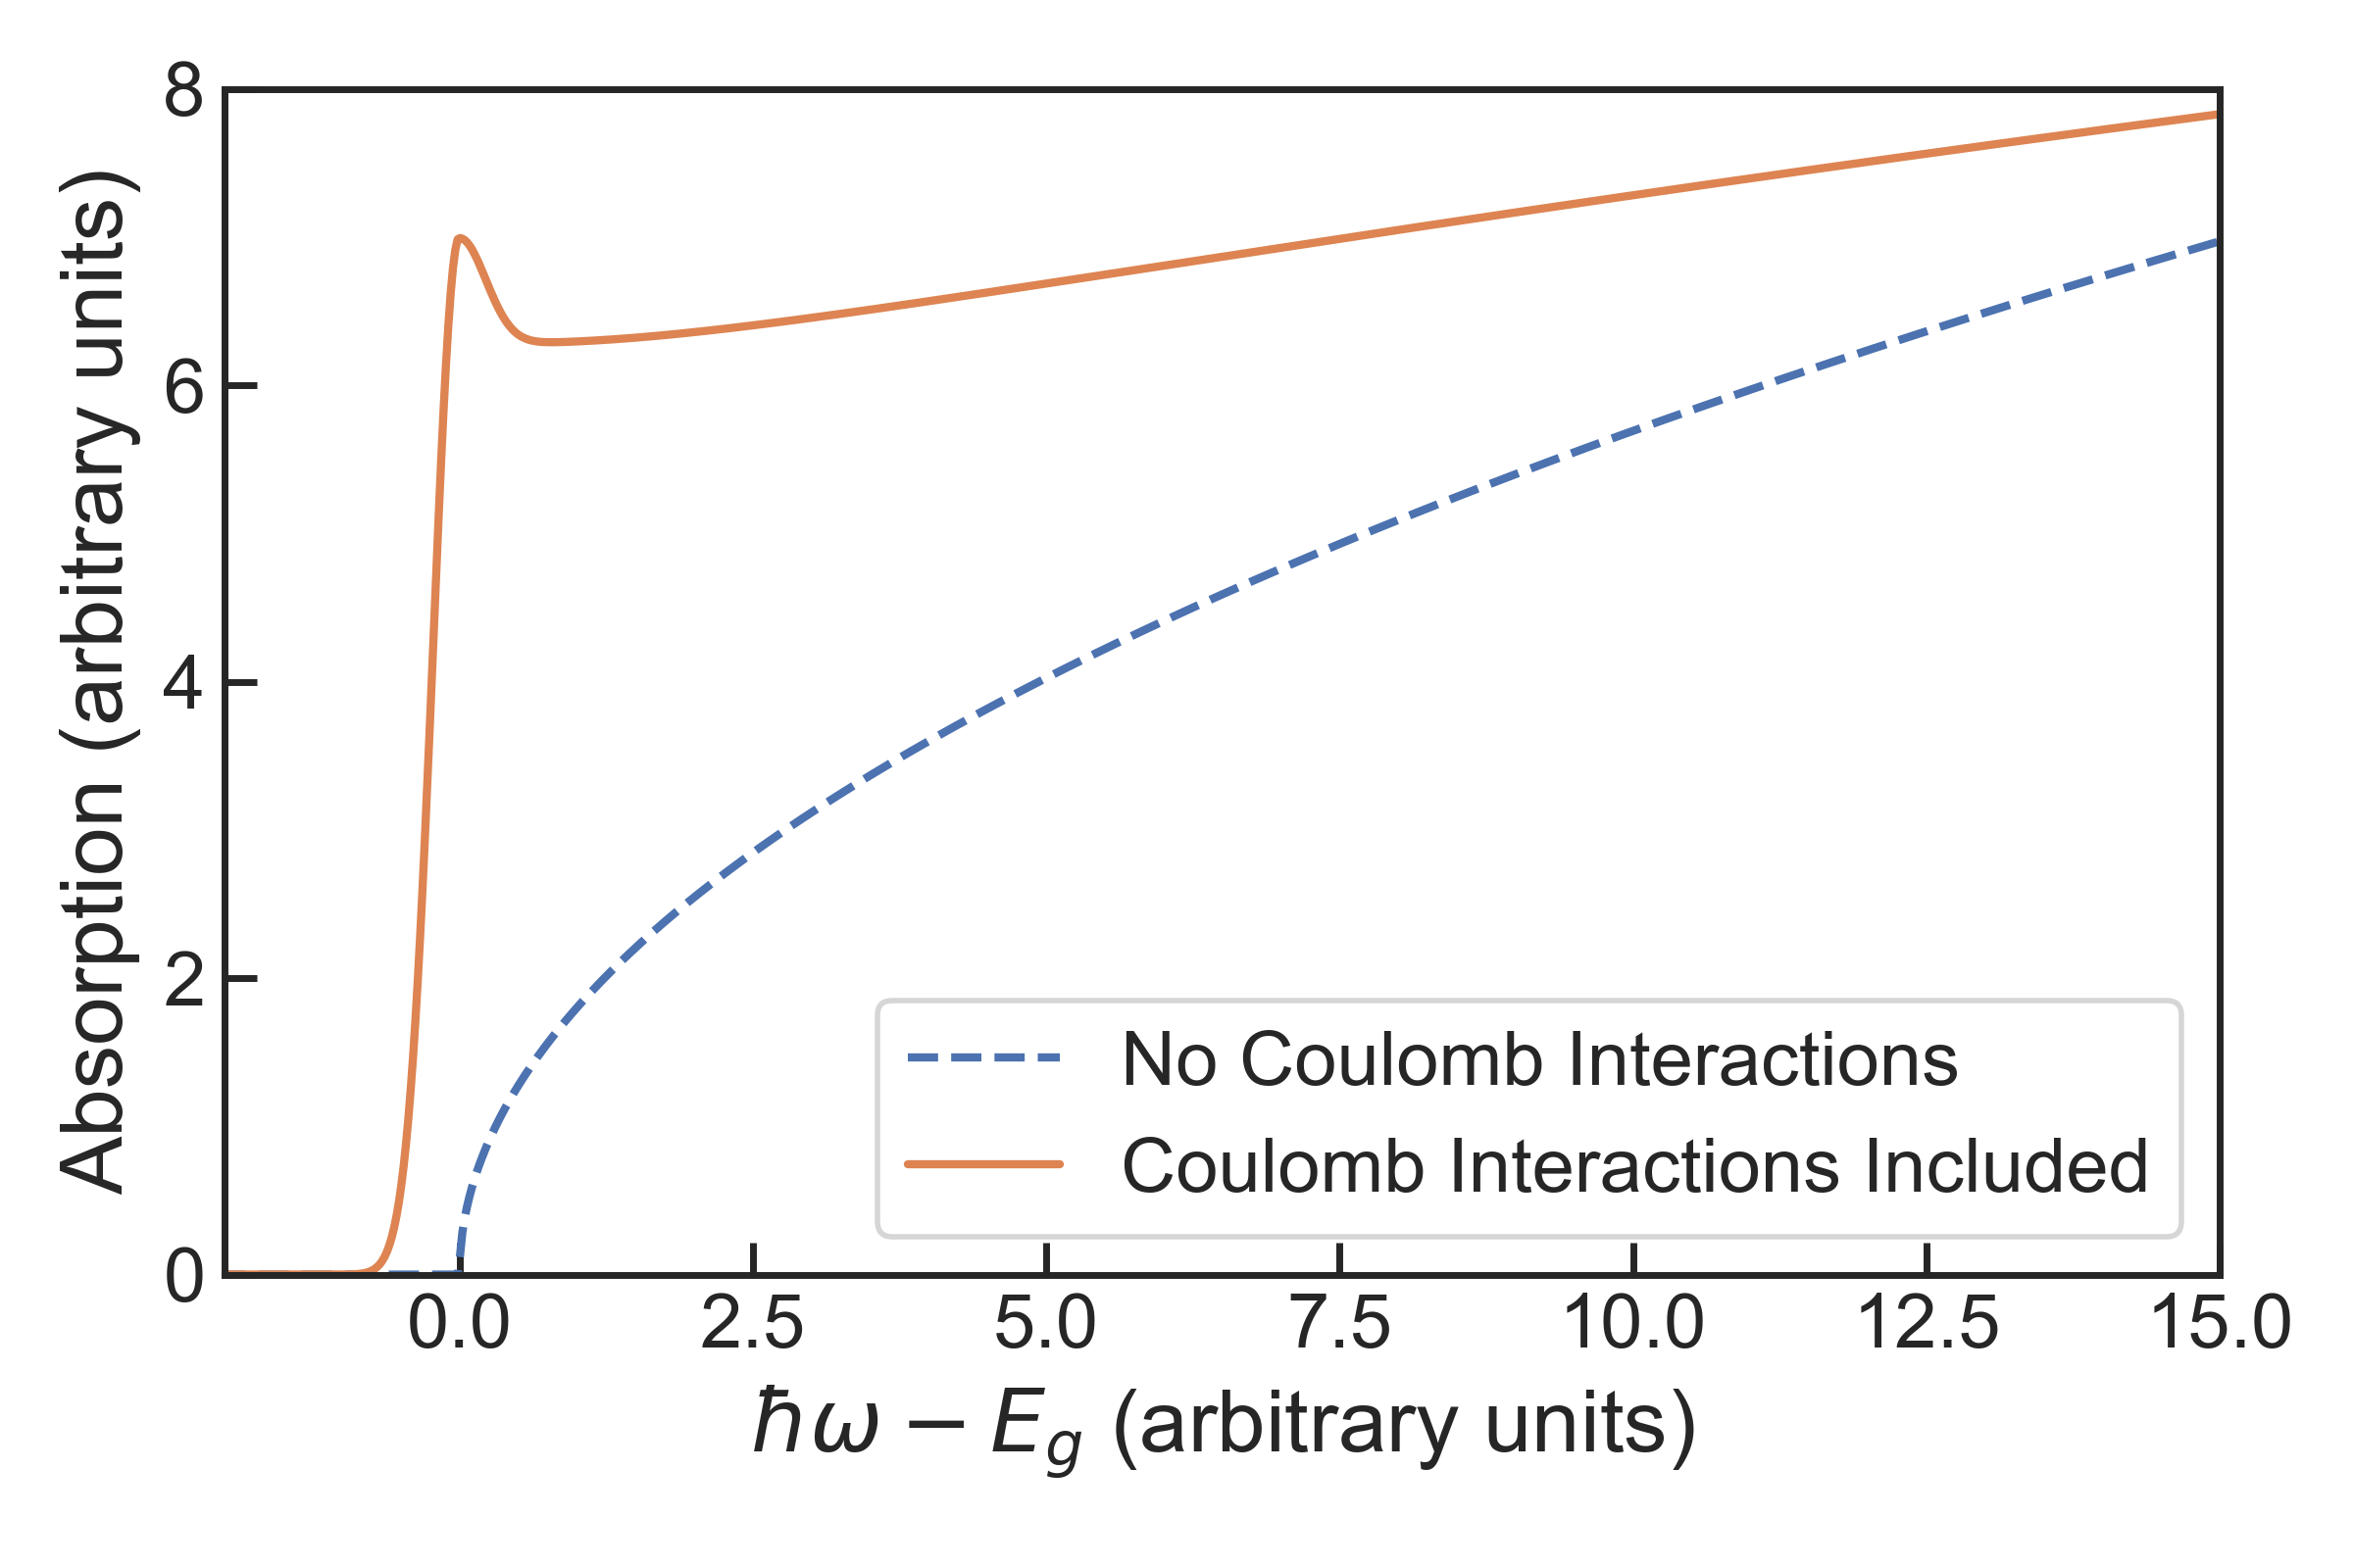
For 3-D materials, the Sommerfeld factor enhances interband absorption.

Slide 5
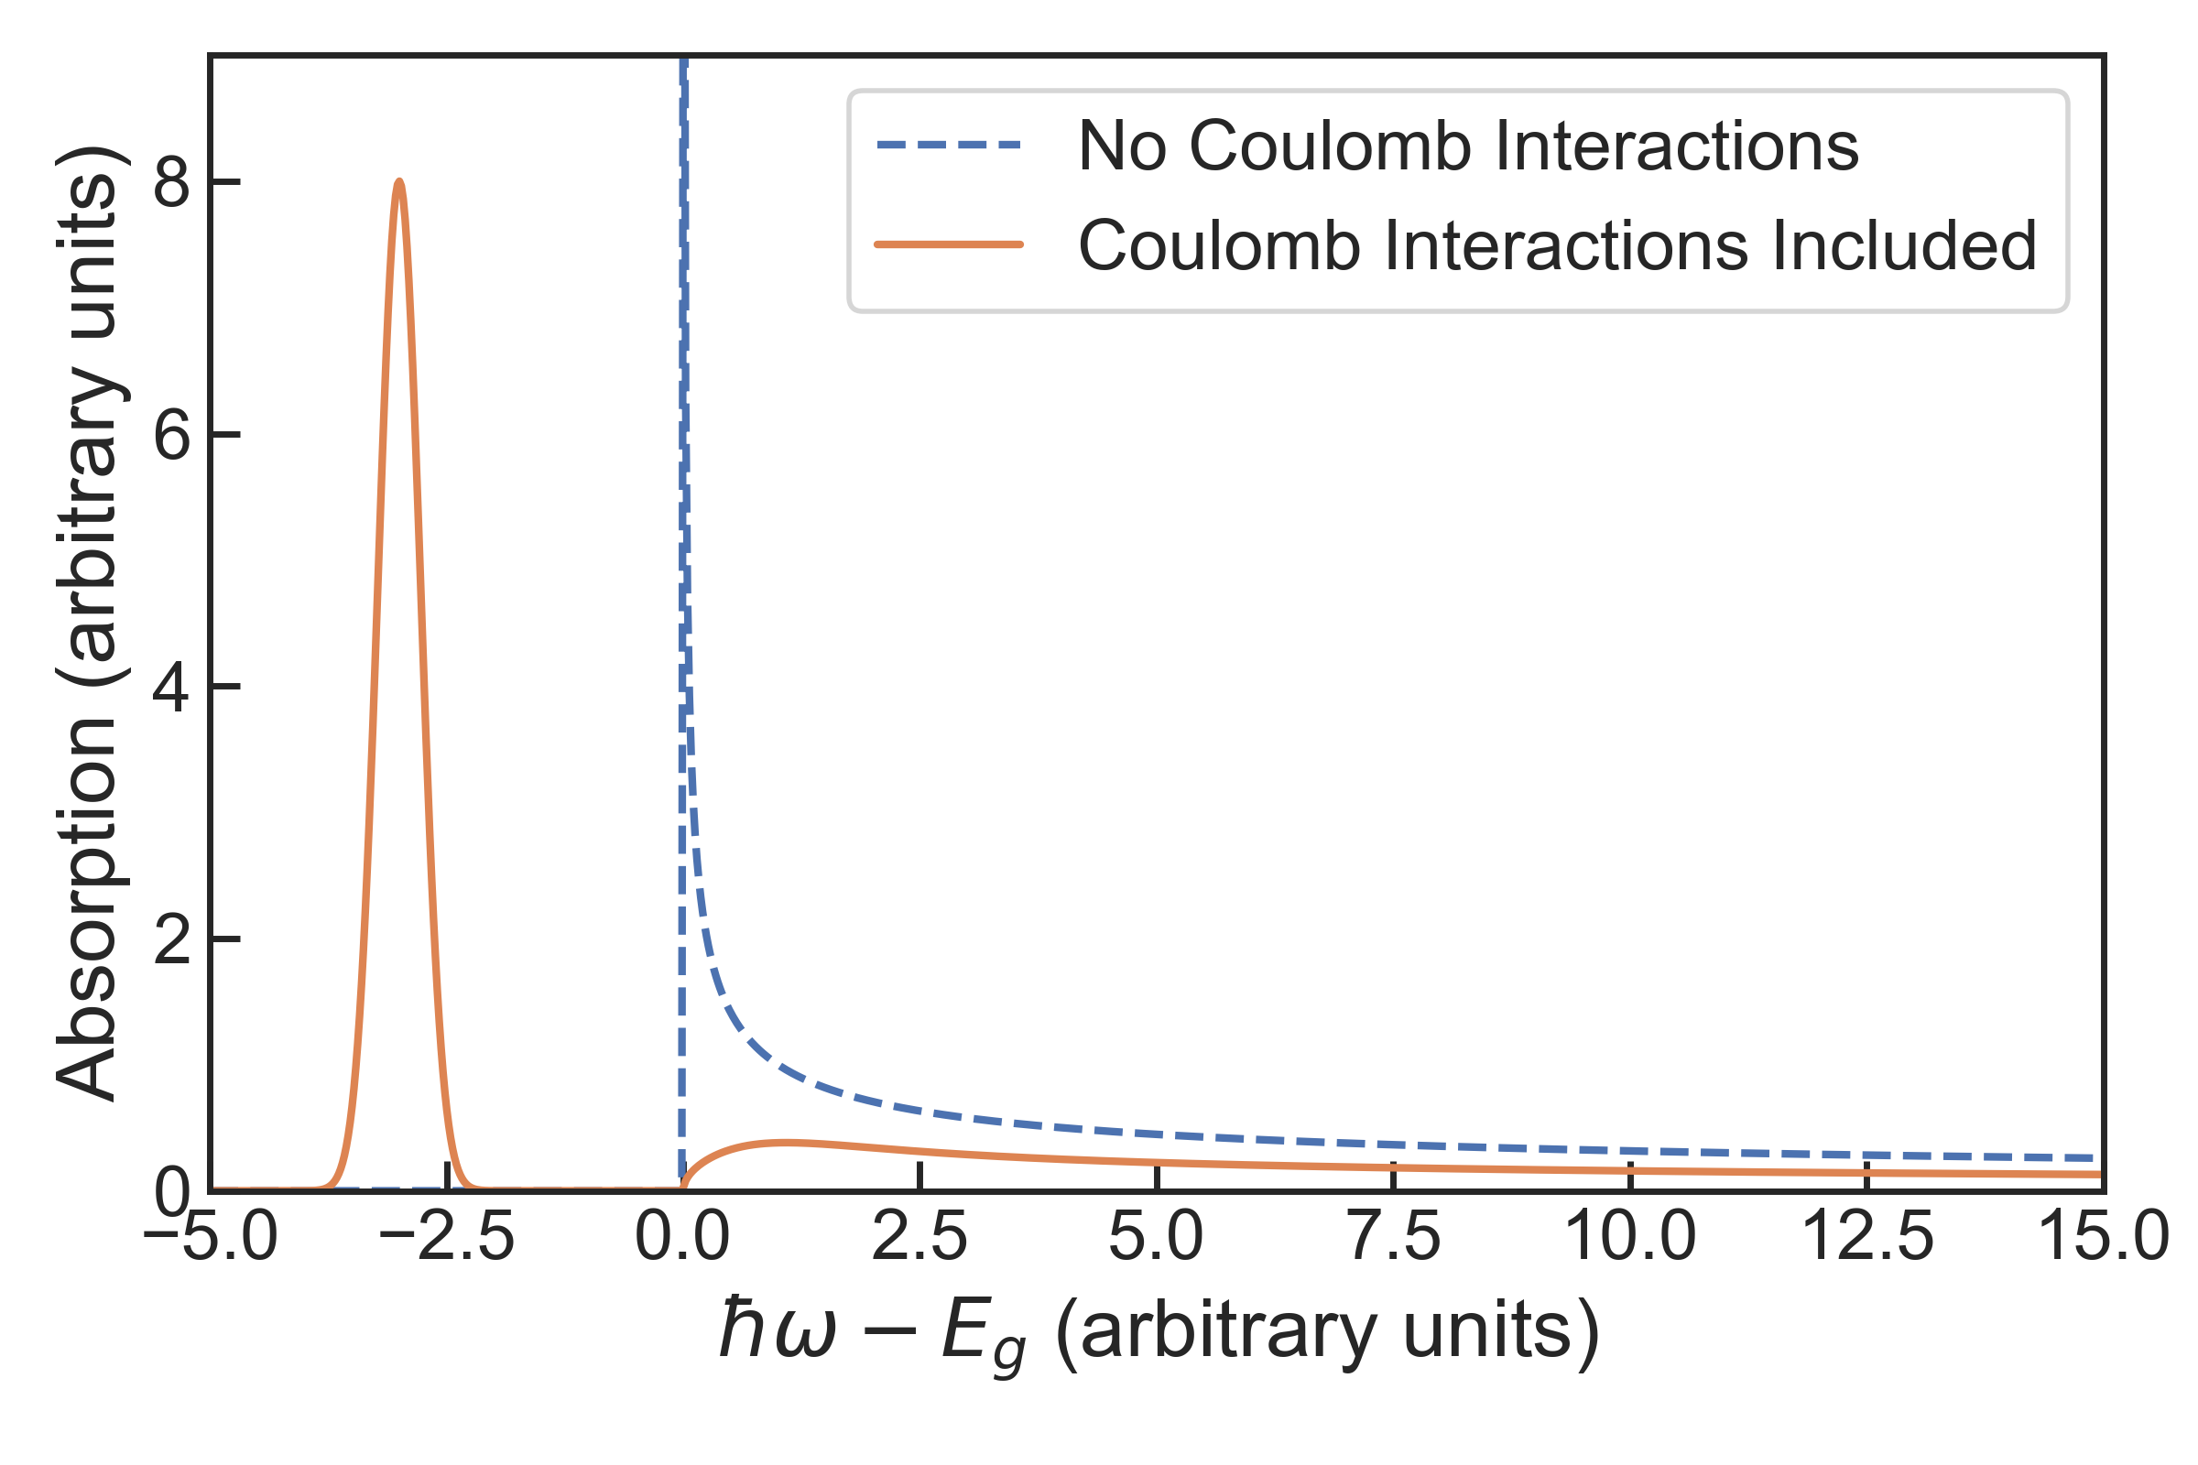
However, for 1-D materials, the Sommerfeld factor suppresses optical absorption of interband states.

Slide 6
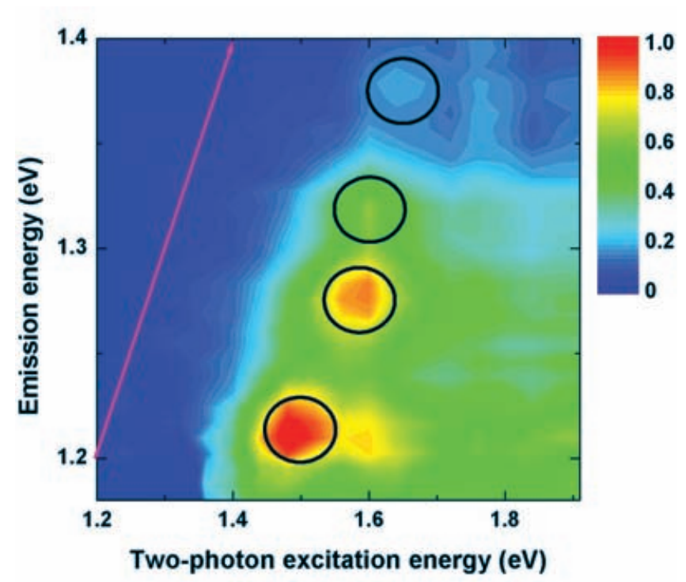
Exciton binding energies in SWCNTs can be on the order of hundreds of meV.

Slide 7
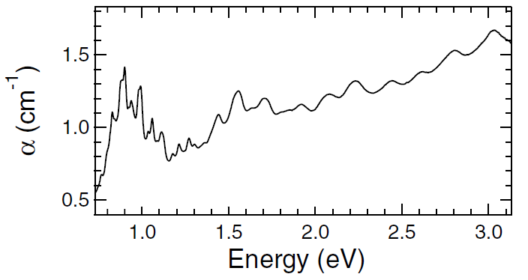
In the past, sample preparation techniques were only capable of making SWCNT suspensiosn with many different chiralities.

Slide 8
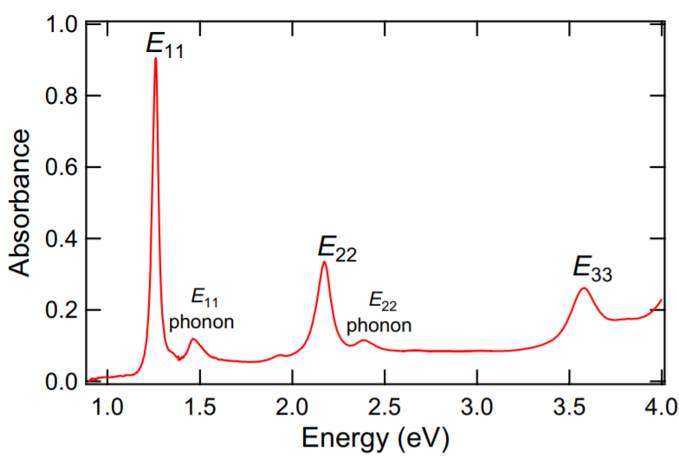
Modern techniques have made single-chirality enriched samples more accessible.

Slide 10
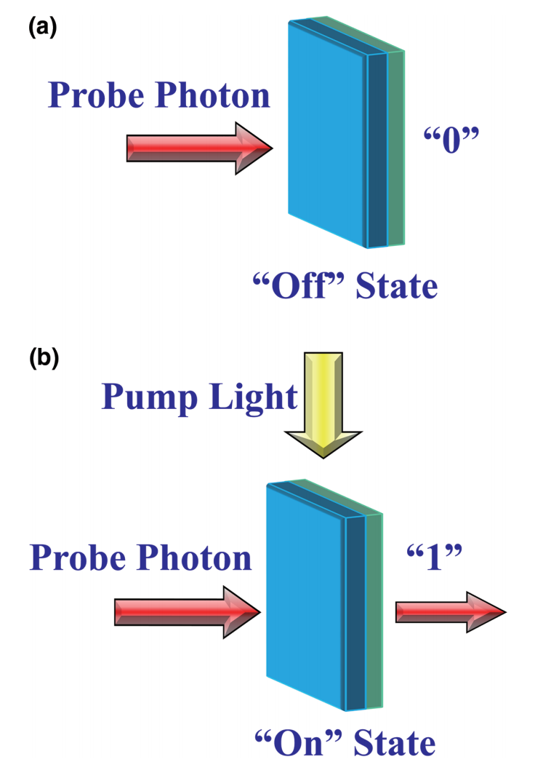

Slide 11
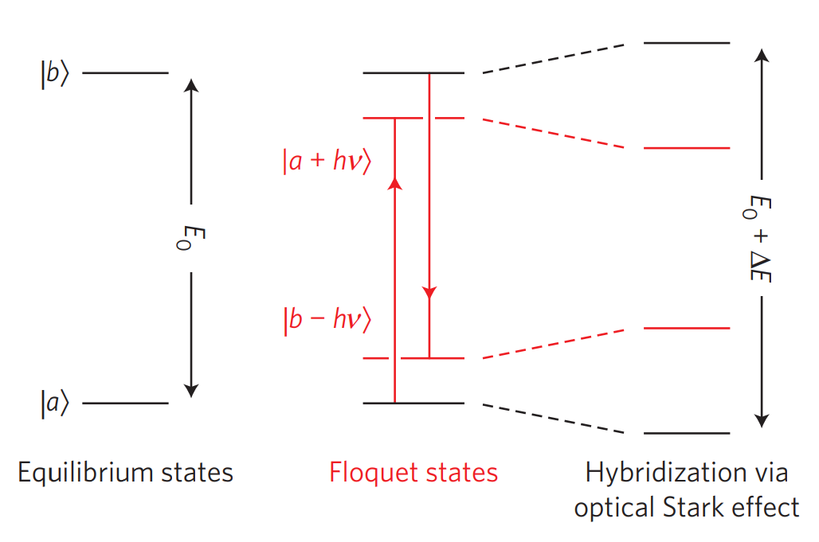

Slide 13
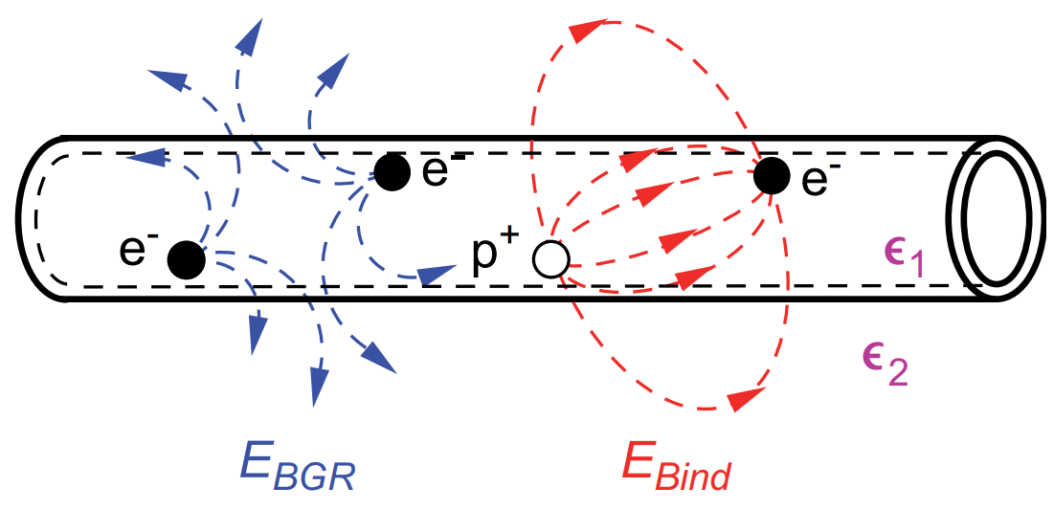
Screening of Coulomb interactions in SWCNTs by an external dielectric can affect bang gap renormalization and the binding energies of excitons.

Slide 14
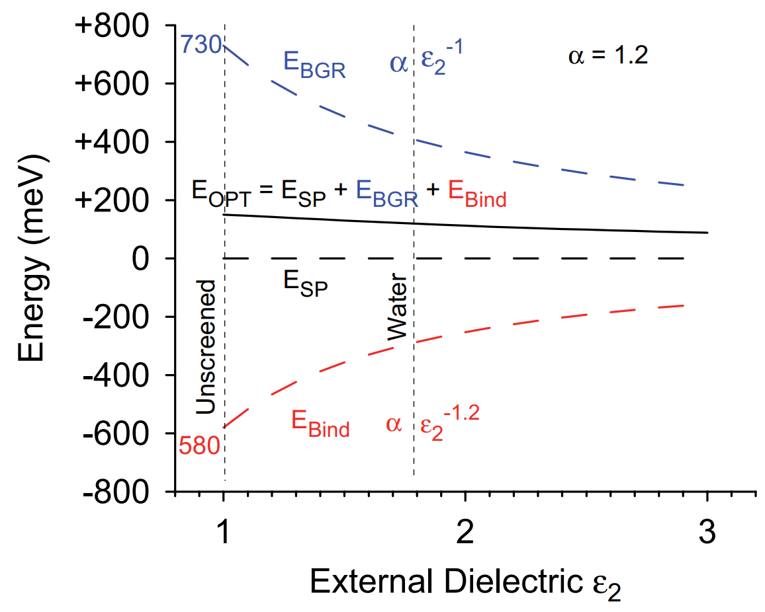
As a result of the screening induced by the external dielectric, optical resonances can redshift as the dielectric constant increases.

Slide 15
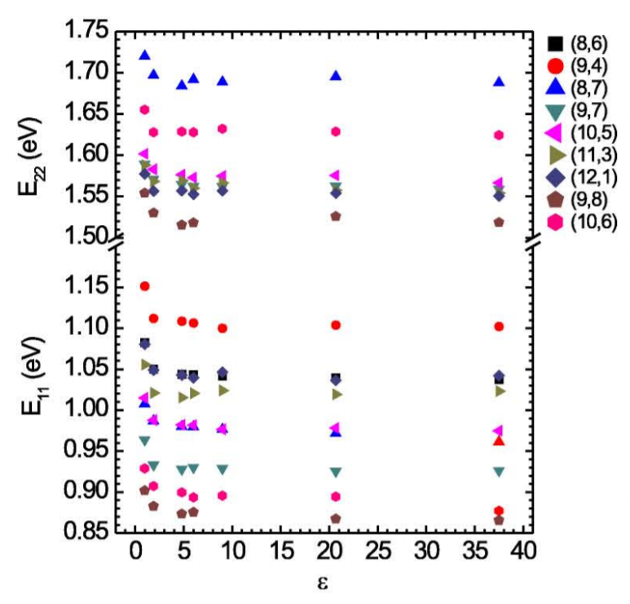
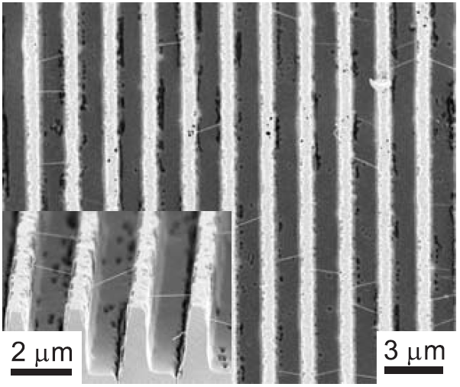

Slide 16
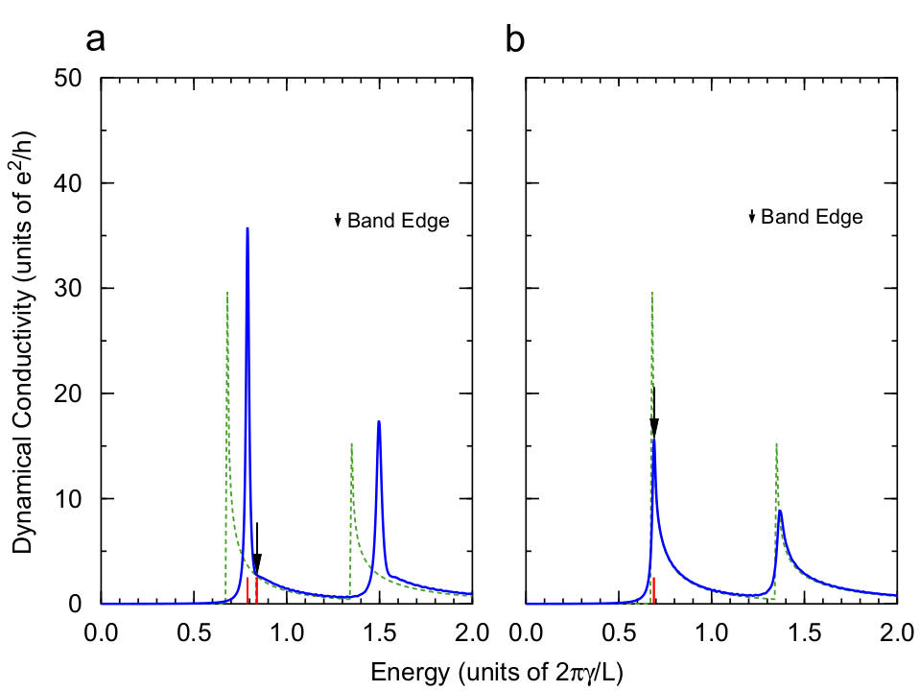

Slide 18
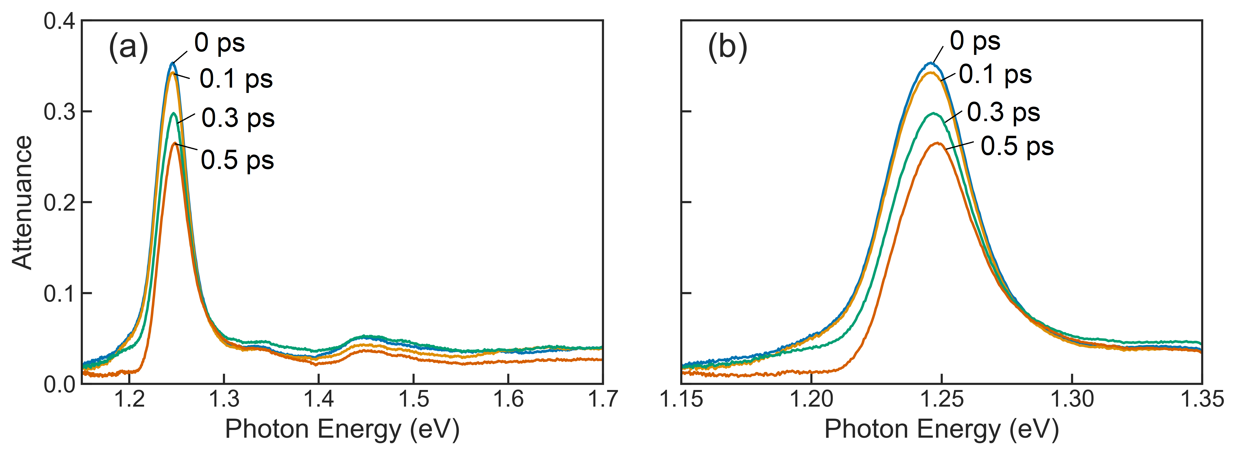

Slide 19
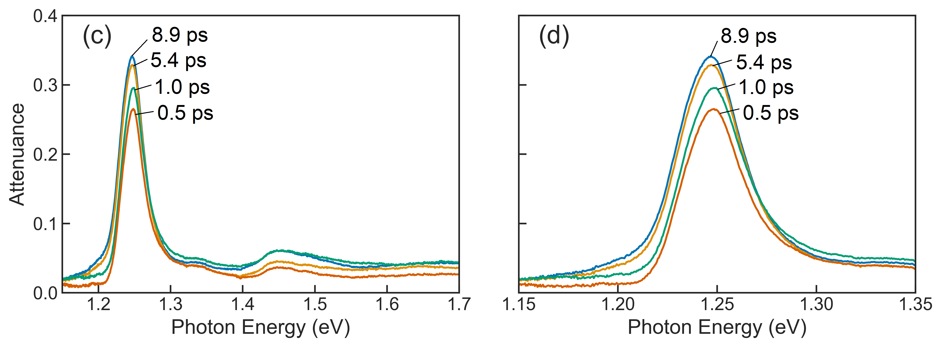

Slide 20
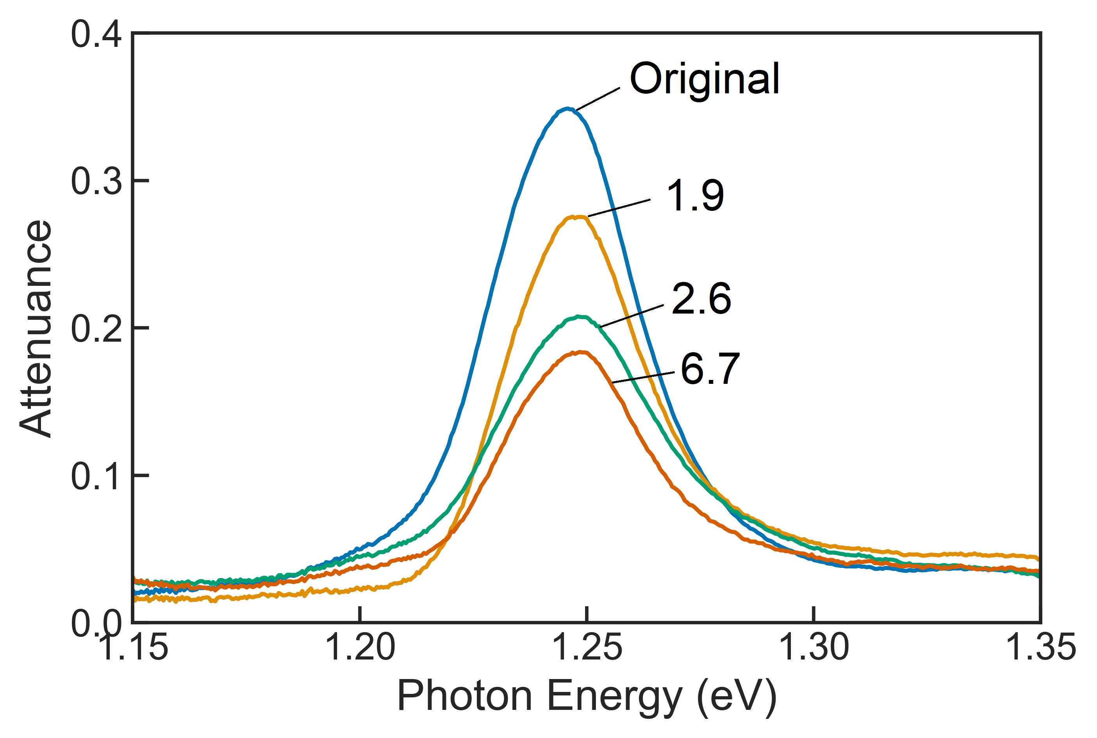

Slide 22
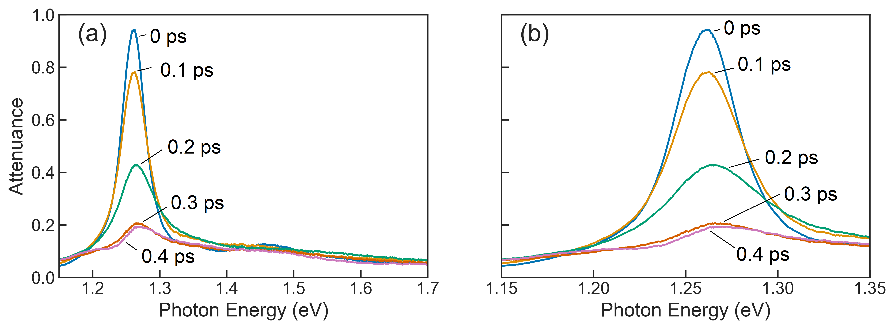

Slide 23
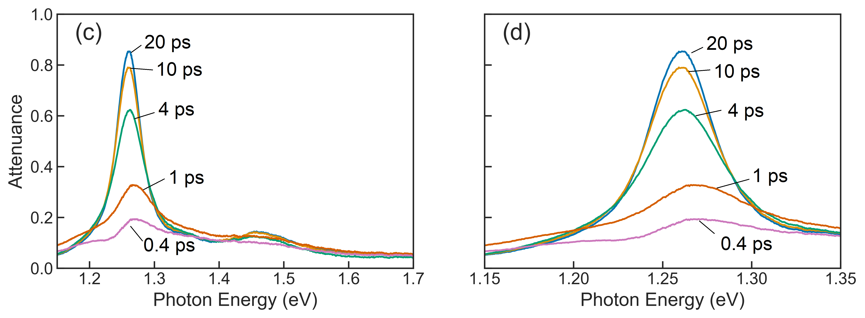

Slide 24
